Slide 1
Welcome to Robotics Club Week4 !
https://kanatpy.github.io/wses-robotics/
2026-04-24
Alp Marangoz

Slide 2


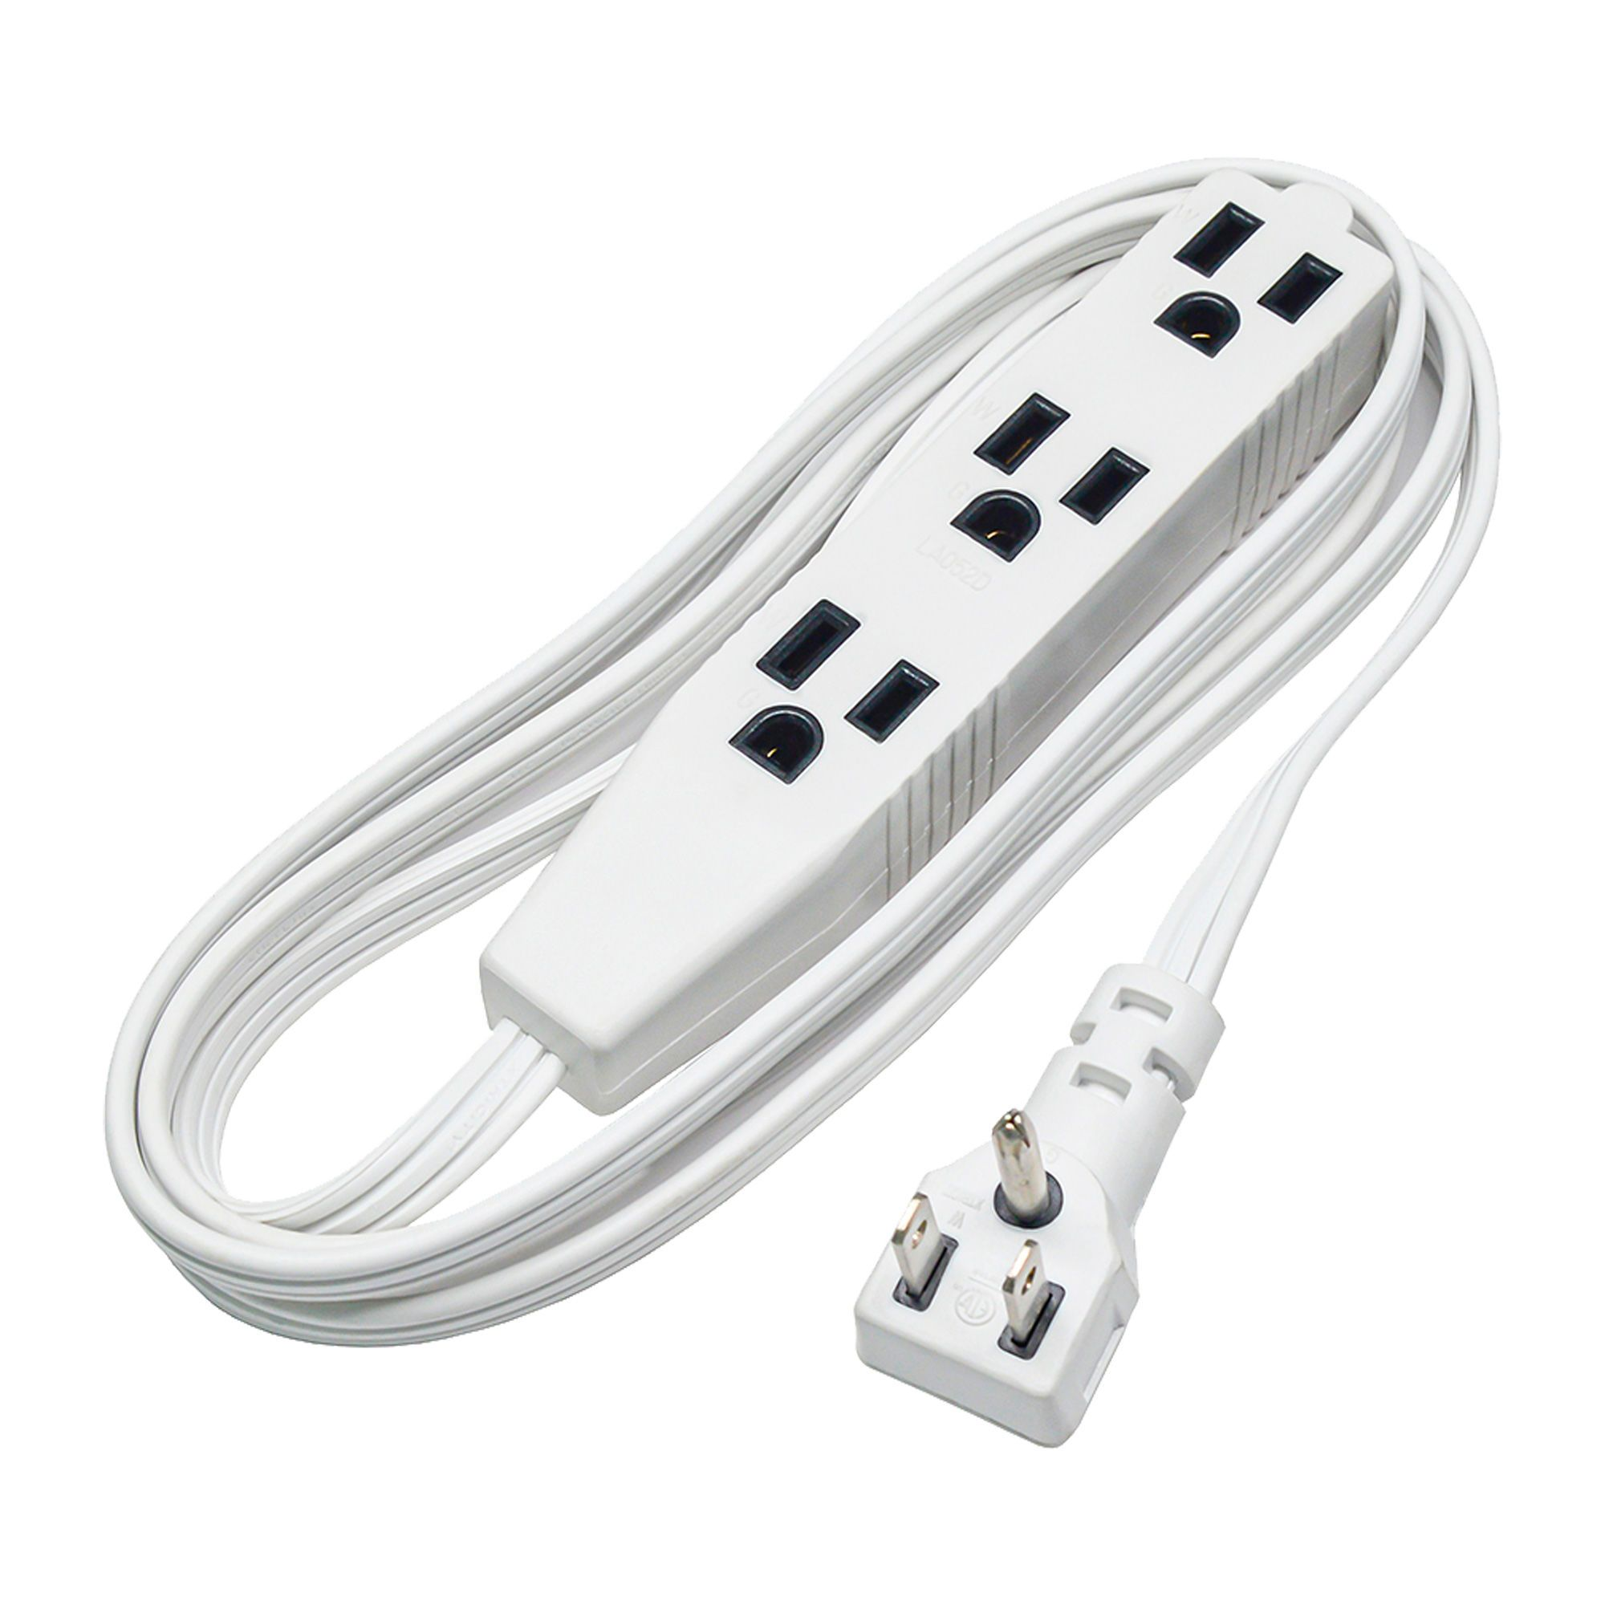

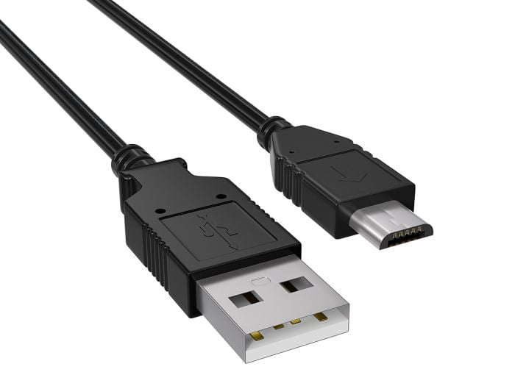
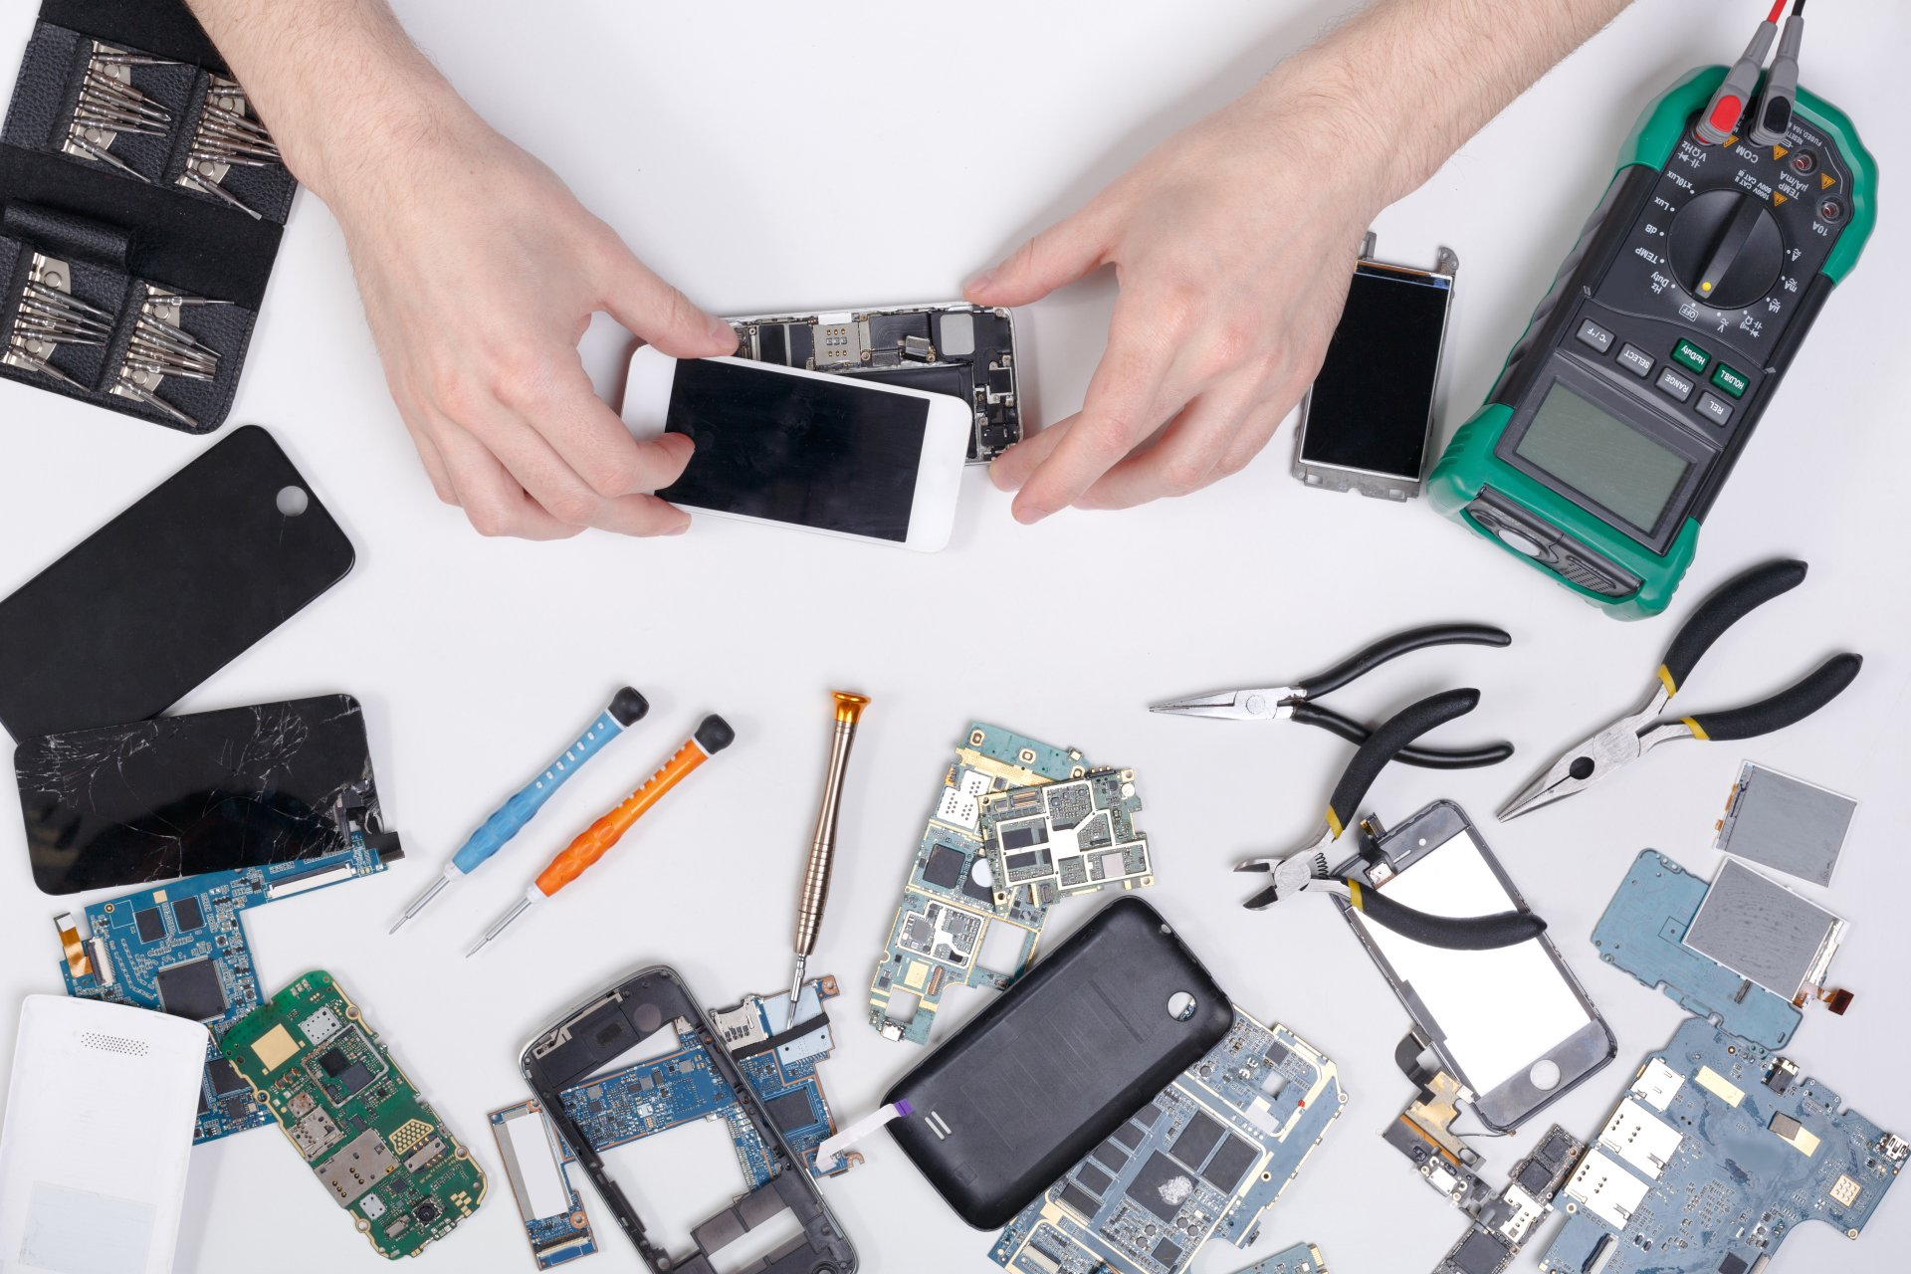
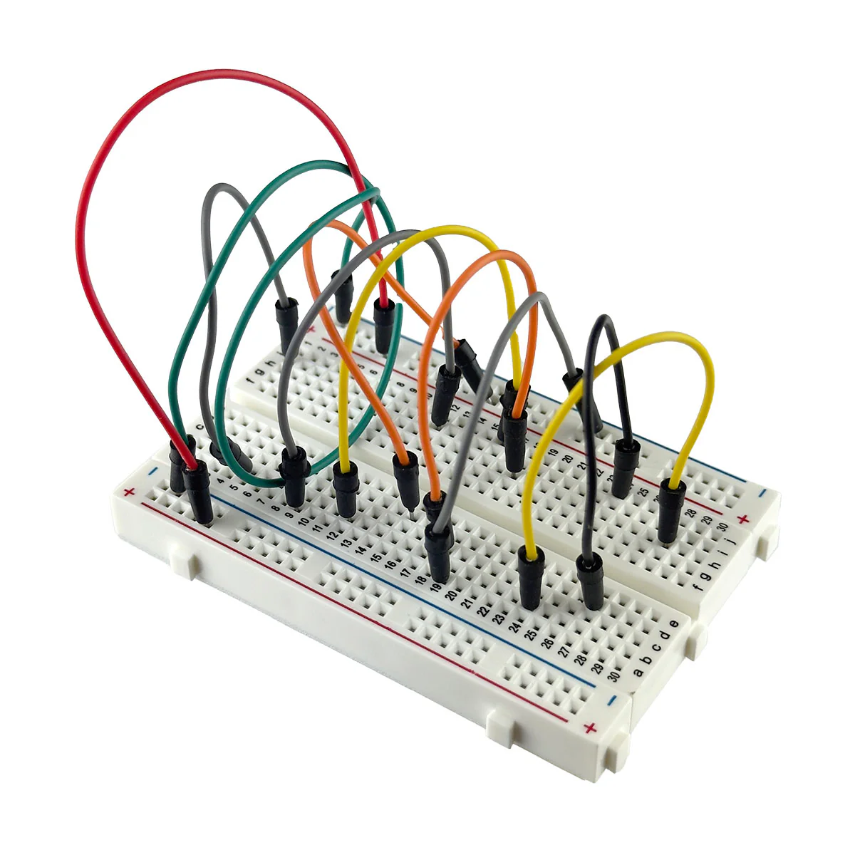
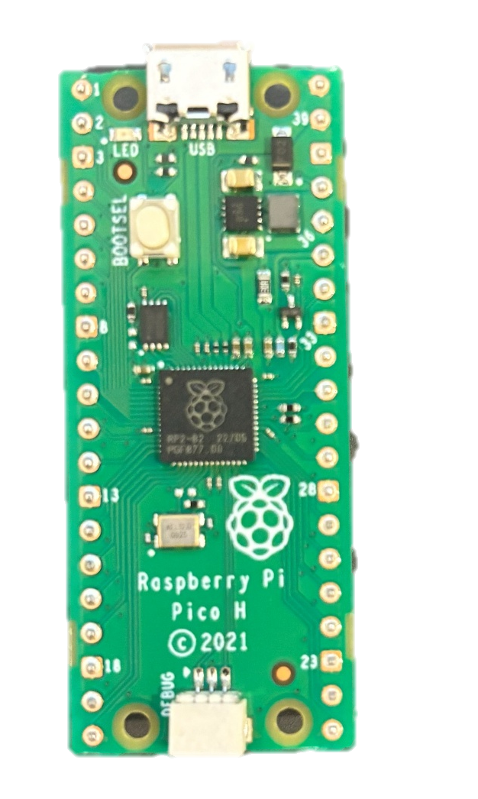
Safety!

Slide 3
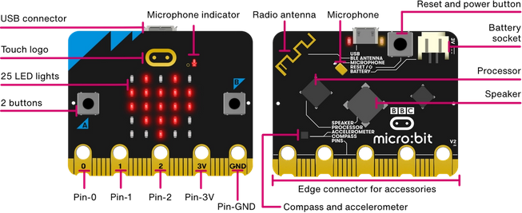
https://microbit.org/get-started/features/overview/

Slide 4
Speed
Time

